Slide 1
Electro-analytical Techniques
Dr. P. G. Umape
PUNE INSTITUTE OF COMPUTER TECHNOLOGY

Slide 2

Electro-analytical Techniques
These are the methods of analysis, which analyses the analyte sample by measuring the potential and/or current of the sample using electrochemical cell.
The electrochemical cell is a device, that converts the chemical energy is converted into electrical energy.
The electrochemical cell consists of one anode and a cathode, which are in contact with an electrolytic solution.
Anode is an electrode where oxidation occurs, while at cathode reduction occurs.
This oxidation and reduction reaction of chemical species present in an electrolytic solution, is responsible for production of electrical energy.

Slide 3
Electro-analytical Techniques
The electrochemical cell can be represented as
Anode ion ion cathode
For example, Daniel cell
Zn Zn⁺⁺ Cu⁺⁺ Cu
The anodic and cathodic reaction occurring in Daniel cell is
At anode: Zn_{(S)} Zn⁺⁺_{(aq)} + 2e⁻
At cathode: Cu⁺⁺_{(aq)} + 2e⁻ Cu _{(S)}
Total cell reaction: Zn_{(S)} + Cu⁺⁺_{(aq)} Zn⁺⁺_{(aq)} + Cu _{(S)}

Slide 4
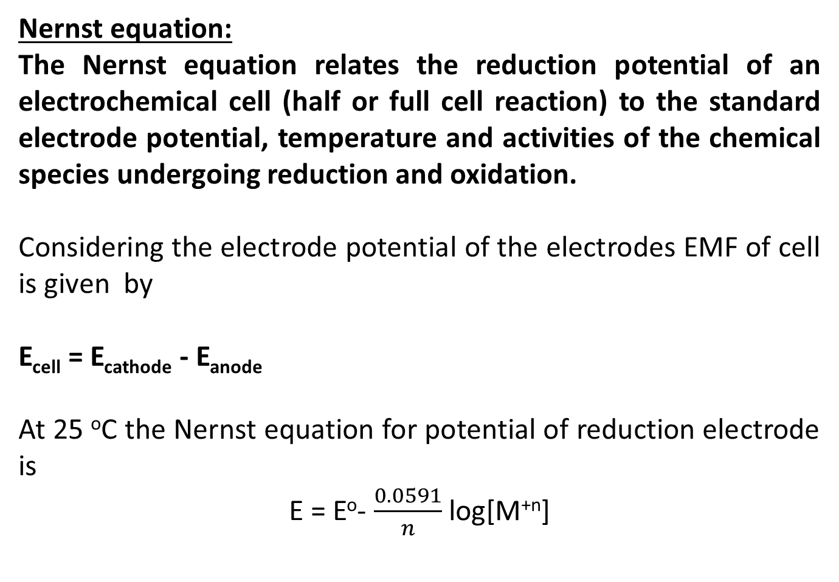
Electro-analytical Techniques
Nernst equation:
The Nernst equation relates the reduction potential of an electrochemical cell (half or full cell reaction) to the standard electrode potential, temperature and activities of the chemical species undergoing reduction and oxidation.
Considering the electrode potential of the electrodes EMF of cell is given by
E_{cell} = E_{cathode} - E_{anode}
At 25 ºC the Nernst equation for potential of reduction electrode is
E = Eº- $\frac{0.0591}{n}$ log[M^{+n}]

Slide 5
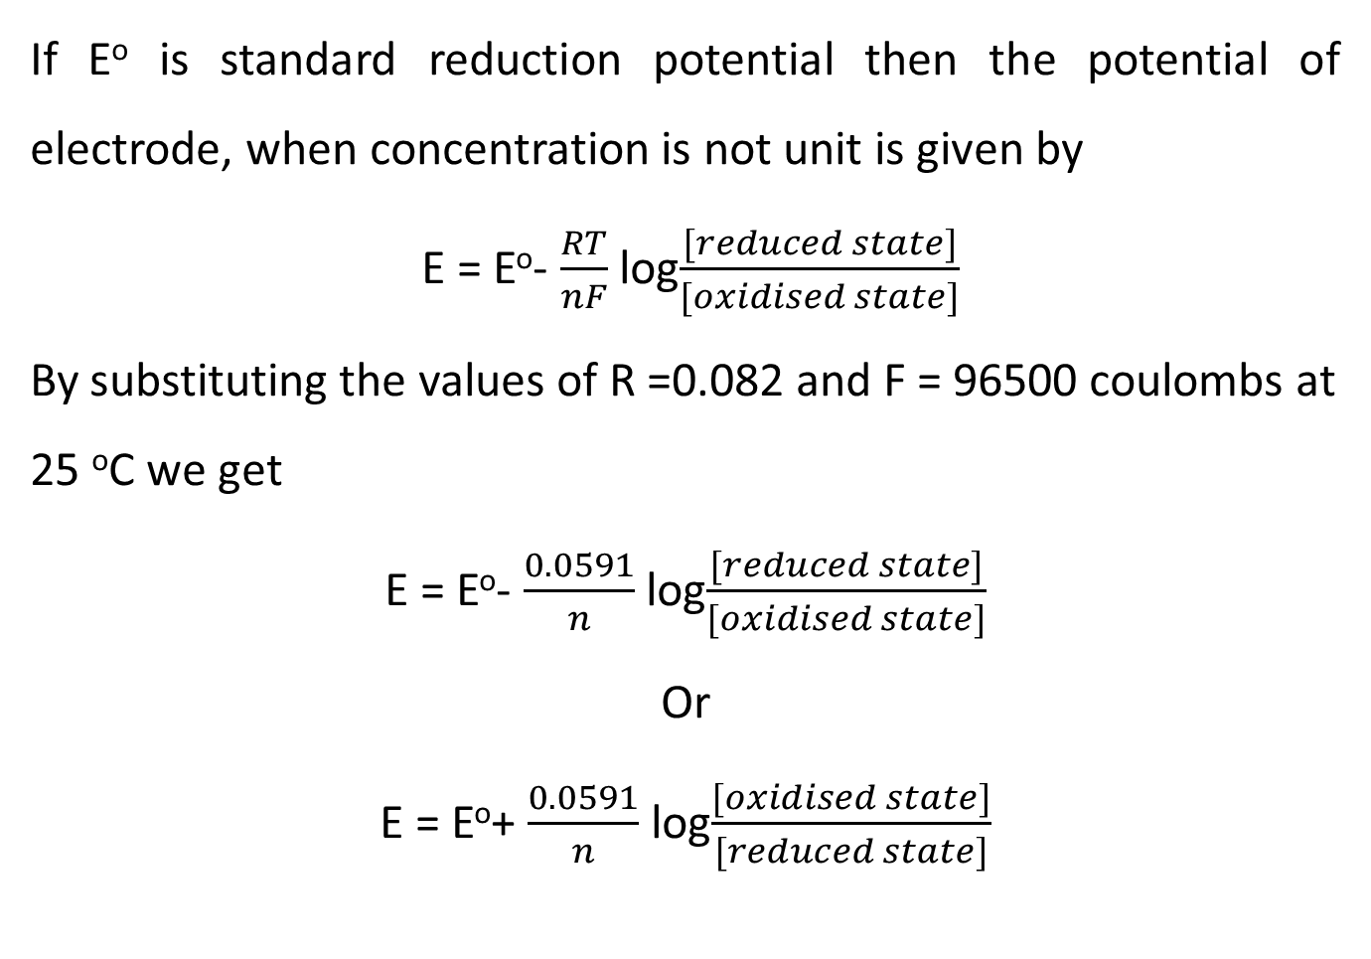
Electro-analytical Techniques
If Eº is standard reduction potential then the potential of electrode, when concentration is not unit is given by
E = Eº- $\frac{RT}{nF}$ log$\frac{[reduced state]}{[oxidised state]}$
By substituting the values of R =0.082 and F = 96500 coulombs at 25 ºC we get
E = Eº- $\frac{0.0591}{n}$ log$\frac{[reduced state]}{[oxidised state]}$
Or
E = Eº+ $\frac{0.0591}{n}$ log$\frac{[oxidised state]}{[reduced state]}$

Slide 6
Electrodes
Reference electrode:
The electrode which produces stable and reproducible potential irrespective of the type and concentration of solution in which it is immersed.
The reference electrode completes the cell by acting as a half cell and provide stable electrode potential, against which indicator electrode is compared and measured.
e.g. calomel electrode, standard hydrogen electrode, silver-silver chloride electrode, Copper-Copper sulphate electrode etc.
Indicator electrode:
The electrode of which electrode potential varies with type and concentration of solution in which it is immersed.
Indicator electrode is used to analyse the analyte sample based on potential or conductivity shown by the electrode when in contact with analyte sample.

Slide 7
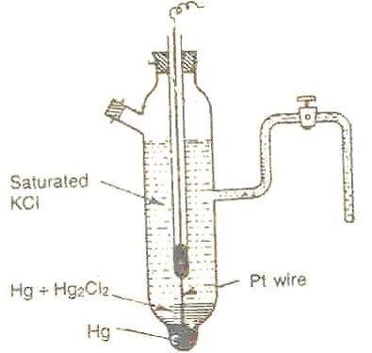
Electrodes

Slide 8
Electrodes
Construction:
It consists of a narrow glass tube with tapering lower end and the bottom of end is porous.
The bottom of glass tube is filled with liquid Mercury.
Above the liquid Mercury paste of Hg-Hg2Cl2 is placed and the electrode is filled with KCl solution.
In order to make optical contact with outer circuit a platinum wire is deep in liquid Mercury.
In some calomel electrodes side tube filled with gel is provided, which will act as salt bridge for making electrical contact.

Slide 9
Electrodes
Calomel electrode is represented by
Pt, Hg Hg₂Cl₂ Cl⁻
Cell Reactions:
2 Hg + 2 Cl⁻ Hg₂Cl₂ + 2e⁻ (If Calomel electrode acts as an anode)
Hg₂Cl₂ + 2e⁻ 2 Hg + 2 Cl⁻ (If Calomel electrode acts as a cathode)
The reduction potential of the calomel electrode is given by
E = Eº- 0.0591log₁₀[Cl⁻]
When Calomel electrode is connected to standard hydrogen electrode, the EMF of cell is equal to potential of Calomel electrode

Slide 10
Electrodes
The potential of Calomel electrode depends on the concentration of KCl solution inside the Calomel electrode.
In other words potential of Calomel electrode depends on concentration of Cl⁻
Demerits of Calomel electrode:
It cannot be used above 50 ºC as Hg₂Cl₂ decomposes.
Both Hg and Hg₂Cl₂ are poisonous
Concentration of KCl | Saturated KCl | 1M KCl | O.1 M KCl
Eº of Calomel | 0.2422 V | 0.281 V | 0.3334 V

Slide 11
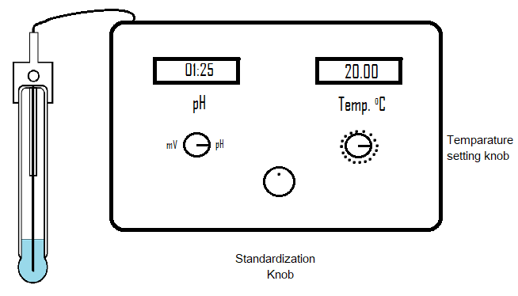
Standardization of pH meter

Slide 12
Standardization of pH meter
Standardization/Calibration process:
Activate the glass electrode and connect to the pH meter.
Connect the pH meter to electrical supply and switch on the pH meter.
Clean the glass electrode by distilled water
Immerse the glass electrode in a solution of known pH (Buffer solution of pH 4/10).
Adjust the temperature to 20 ⁰C by temperature knob provided with pH meter.

Slide 13
Standardization of pH meter
Standardization/Calibration process:
Once the temperature is achieved, check the pH on pH display.
If the pH in the display is deviating from the pH value of buffer solution.
Adjust the standardization knob to the pH value of buffer.
Now the pH meter is said to be standardized.
Do not disturb the standardization knob throughout the pH analysis.
After use of glass electrode keep it in the distilled water to keep it hydrated.

Slide 14
SA-SB pH metric titration
Strong Acid- Strong Base pH metric titration
Consider a strong acid HCl and strong base NaOH
Strong acid is taken in flask while strong base is taken in burette
As both are strong acid and strong base they undergoes complete dissociation
The net reaction during the titration is as follows
Na⁺ + ⁻OH + H⁺ + Cl⁻ Na⁺ + Cl⁻ + H₂O

Slide 15
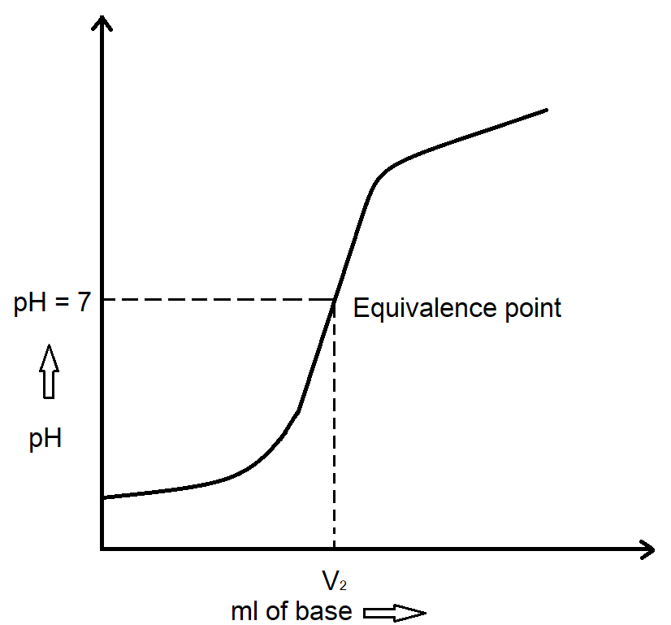
SA-SB pH metric titration
Strong Acid- Strong Base pH metric titration
Consider strong acid (HCl) and strong base (NaOH) conductometric titration.

Slide 16
SA-SB pH metric titration
Strong Acid- Strong Base pH metric titration
Procedure:
Take V₁ ml of acid in a conical flask of unknown concentration
Fill the burette with N₂ normal NaOH and titrate.
Check the pH of Solution after addition of 0.5 ml of NaOH each time.
Initially pH rises gradually upto pH 4 after that a sudden rise in pH is observed upto pH 10, near equivalence point.
After that gradual rise in pH takes place by continuing the addition of NaOH addition.

Slide 17
SA-SB pH metric titration
Strong Acid- Strong Base pH metric titration
The equivalence point of the titration is 7.
From the graph
The V₂ is the volume of NaOH required at equivalence point.
If V₁ is volume of acid taken for titration, V₂ is the burette reading and N₂ is the normality of NaOH, then Normality of HCl (N₁) can be calculated as N₁V₁ = N₂V₂

Slide 18
Summary
How to activate glass electrode?
Why activation of glass electrode is needed?
How to standardise pH meter?
SA-SB pH metric titration

